Slide 1
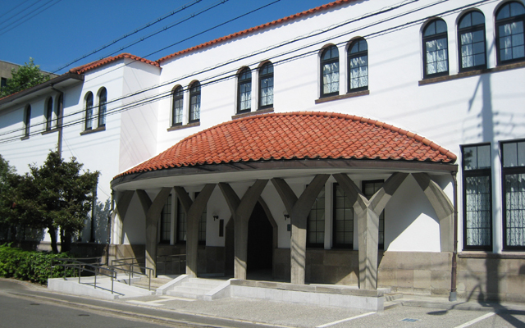
京都大学大学院文学研究科附属
応用哲学・倫理学教育研究センター
開設記念国際シンポジウム
「応用哲学と応用倫理のいま」
シンポジスト
Takashi Yagisawa (カリフォルニア州立大学）
Szu-Ting Chen （国立清華大学：台湾）
Kai-Yuan Cheng (国立中正大学：台湾）
Sang-Wook Yi (漢陽大学校：韓国）
Robert Sparrow (モナシュ大学：オーストラリア）
（全て英語講演：通訳無し）
2012年4月23日（月） 午後2時〜6時
懇親会 午後6時〜８時（参加費:3,500円）
※懇親会参加者はなるべく事前に下記アドレスまでご連絡ください
於：京都大学楽友会館
お問い合わせ先：CAPE@bun.kyoto-u.ac.jp

Slide 2
講演内容
Takashi Yagisawa: Applied Metaphysics: Contents of Narrative Cinema
The so-called possible-worlds framework provides a powerful theoretical arena in which
a variety of philosophical theorizing can be pursued with much benefit. A natural extension
of it is the impossible-worlds framework. It gives philosophical respectability to the idea of
the impossible. A number of topics may be usefully discussed within this framework,
among which is the content of a typical narrative film. I shall sketch the reason why the
contents of narrative films are typically impossible in two or more different senses of
"impossible" and how these senses are treated in the impossible-worlds framework.
Szu-Ting Chen: Many Faces of Causal Inquiry and Its Implications for Scientific Discovery
Although causal inquiry has long been regarded as one of the core elements of science, the focus of the philosophical investigation of causality has changed over time since at least the modern era. The modern philosophical analysis of causality has been going through three stages—i.e., metaphysical, epistemological, and methodological stages—to prove that it has its uses in providing suggestions for scientific discovery of causal connection between relevant factors. The main purpose of this presentation is to briefly go through the three developmental stages and then move on to focus on the cases of causal inquiry that have their implications for practical scientific discovery.

Slide 3
講演内容
Kai-Yuan Cheng: The Reality and Value of Virtual Experience in Online Games
The aim of this paper is to address the following question: Is the experience which we
obtain from on-line games or cyberspace ontologically inferior to that which we obtain
from interacting with the physical world? Answering this question requires that we
illuminate the reality and value of digital experience—experience that we acquire
from the so-called “virtual reality”. Some philosophical considerations are offered in
support of the view that there is no fundamental difference between the two worlds
—the digital and the physical—in terms of reality and value.

Slide 4
講演内容
Sang-Wook Yi :Recovery and Enhancement: Ethics of Being Better than Human
Medical treatments including drugs and surgery are usually understood to help patients recover their health. If you have appendicitis, your doctor might suggest appendectomy. If you suffer from indigestion, you might consider taking a digestive. On the other hand, we are also used to various types of non-medical enhancements including legally permitted ones such as coffee and illegal substances such as steroids for athletes. At first, the distinction between recovery and enhancement is trivial, or at least conceptually clear enough to make no practical difficulties in deciding our proper attitudes towards them. Recovery to health through medical treatments is desirable, while enhancement from normal ability of human requires our judgments concerning its ethical, social, and legal acceptability.
Some disagree and question the legitimacy of the distinction, claiming that there is no intrinsic difference between medical treatments to recover human health and all sorts of enhancements for performing better than average human. I will consider the argument offered by Buchanan, and examine if his ‘continuity’ claim actually holds. I will argue that despite conceptual difficulties in providing a unique, clear-cut line between recovery and enhancement, the line is still significant to draw for our moral, social and legal decision- making. For the matter of consequential significance, conceptual fuzziness tells us little more than the importance of better institutions.

Slide 5
講演内容
Robert Sparrow: What makes a human life go well…. And why it matters.
This presentation will ask how we can tell when someone's life is going well or – to put it another way – how we should evaluate well-being. I will introduce three popular answers to this question – hedonism, preference-satisfaction accounts, and “objective list” theories – and discuss the advantages and disadvantages of each. I will argue that which theory we choose has important implications across a wide range of problems in applied ethics, including the philosophy of education, care for the elderly, and the ethics of “human enhancement”. Finally, I will explore some of the implications of what I believe to be the most plausible account of well-being, an “objective list” theory.

Slide 6
スケジュール

Slide 7
会場アクセス
市バス「近衛通」下車 徒歩すぐ
JR「京都駅」から（市バスA2のりば）
206系統「東山通 北大路バスターミナルゆき」
乗車時間約30分
阪急「河原町駅」京阪「四条駅」から 201系統「祇園・百万遍ゆき」約20分 31系統「東山通 高野・岩倉ゆき」約20分
東山三条から 201系統「百万遍・千本今出川ゆき」約10分 206系統「高野 北大路バスターミナルゆき」約10分
駐車場無し、公共交通機関をご利用ください

